Slide 1

Title of the topic:
RV College of
Engineering
AMBULANCE MANAGEMENT SYSTEM
Nidhi Vinayak Kulkarni -RVCE23BCS034
Sai Arun Kumar C RVCE23BIS046
Poorvi Bellur RVCE23BCD050
Aditya Kaushik RVCE23BAI043
RV College of Engineering
Submitted to
Dr. Sindhu D V
Prof.Apoorva Uday Kumar Chate
Prof. Manonmani S
Prof. Vishal
‹#›
Notes:
‹#›

Slide 2
Abstract
Ambulance Services are said to be a ‘mobile hospital’ and it plays an important role of saving patient lives.
As there is increase in population and traffic congestion the ambulance might get late or might not be available to people who are in need.
In today's fast-paced world, the efficient and timely delivery of emergency medical services is paramount.
An Ambulance Management System serves as a crucial tool in optimizing and streamlining the operations of emergency medical services, ensuring that precious moments are not lost during critical situations.
This comprehensive system integrates cutting-edge technologies with a user-friendly interface to enhance the coordination, communication, and response times of ambulance services.
‹#›

Slide 3
Problem Statement
In the current healthcare landscape, the effectiveness of emergency medical services is hindered by
operational inefficiencies
lack of real-time communication and
traffic congestions.
The absence of a centralized and technologically advanced Ambulance Management System makes these challenges, leading to delayed response times during emergencies, inefficient allocation of resources, and an overall decrease in the quality of patient care.
‹#›

Slide 4
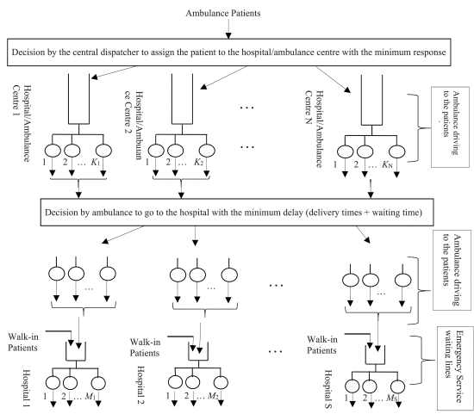
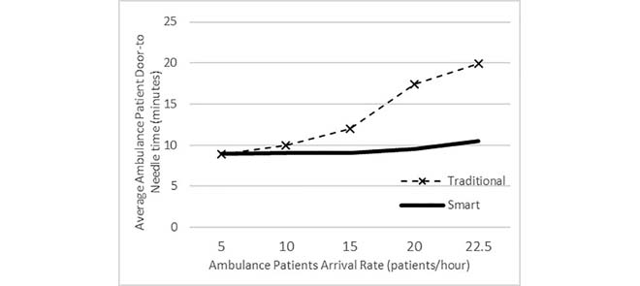
Problem Statement
Average ambulance patient door-to-needle time for non-proportional capacity.
Queuing model of the smart ambulance system.
‹#›

Slide 5
Literature Review
IEEE Papers that we referred to :
TITLE | AUTHORS | BRIEF SUMMARY
Implementation of GUI based Vital Track Ambulance for Patient Health Monitoring | D. G. V, L. M, H. P. Viraj, R. V. Mailapur and M. K (2023) | The ambulance is equipped with a real-time communication system that connects it with the database, enabling healthcare professionals to remotely monitor and advise on patient care in Java GUI.
A Novel Smart Ambulance System, Algorithm Design, Modeling, and Performance Analysis | MOHAMMADA.R. ABDEEN, MOHAMED HOSSAM AHMED HAFEZ SELIEM, TAREK RAHIL SHELTAMI ,TURKI M. ALGHAMDI, AND MUSTAFA EL-NAINAY | Road traffic conditions and hospital information are collected in real-time basis to make optimal decisions (which hospital responds to the patients request and which ambulance it sends,which route the ambulance takes to reach the patient etc)
‹#›

Slide 6
Literature Review
IEEE Papers that we referred to :
TITLE | AUTHORS | BRIEF SUMMARY
Design and Implementation of Free Ambulance Service System in Bandar Lampung City Based on Android Mobile Application | G. F. Nama, C. K. Nugraha and H. D. Septama | This study builds an application that runs on the Android OS to facilitate the ordering process and free ambulance services for the city of Bandar Lampung to be more efficient. Application was built using the PHP programming language on the Web Service side and the Java programming language on the android application side, using MySQL and Firebase Realtime Database as databases.
‹#›

Slide 7
Literature Review
IEEE Papers that we referred to :
TITLE | AUTHORS | BRIEF SUMMARY
Smart Ambulance Management System with Real-Time Patient Monitoring | M. Nithyashree, K. P. Nadgir, P. N and R. S. Rajendran | It comprises a user-friendly mobile application to facilitate the booking and arrival of the ambulance to the patient's spot. The system also integrates primary health sensors such as ECG, temperature, heart rate, and SpO2 monitors, providing continuous, real-time patient health data which is relayed to the hospital authorities
‹#›

Slide 8
Literature Review
IEEE Papers that we referred to :
TITLE | AUTHORS | BRIEF SUMMARY
Smart Ambulance for Traffic Management System | M. P. Karthikeyan, S. R, M. K and K. G | The main objective of this project is to decrease the travelling time of the ambulance. It enriches users with prior information about traffic local convenience real time running information which reduced the travelling time of the commuters and enhances the survival rate.
‹#›

Slide 9
Proposed system vs existing system
Proposed System | Existing System
An efficient java platform to store ambulance data with status availability . Option to view all the ambulance data and choose from the ones available. Aids for fast and efficient management of ambulances by the hospital in order to prevent mismanagement and delays to dispatch ambulances in emergency situations. | In emergency cases the driver will face difficulty to reach accident spot in minimum amount of time because of heavy traffic. Due to this many people may lose their lives and people can contact the ambulance driver only via phone call and explain current situation and place. By this System it would not help the ambulance reach the hospital on time.

Slide 10
System Hardware and Software Specifications
System software
Operating System-Windows and Mac OS
Java development kit (JDK)
Java runtime environment (JRE)
Database management system (DBMS)
Integrated development environment (IDE)
MySQL
System hardware:
1. ASUS vivobook
2. Macbook Pro(M2 chip)
3. Intel core I5 10th generation
4. LAN or wifi connection
‹#›

Slide 11
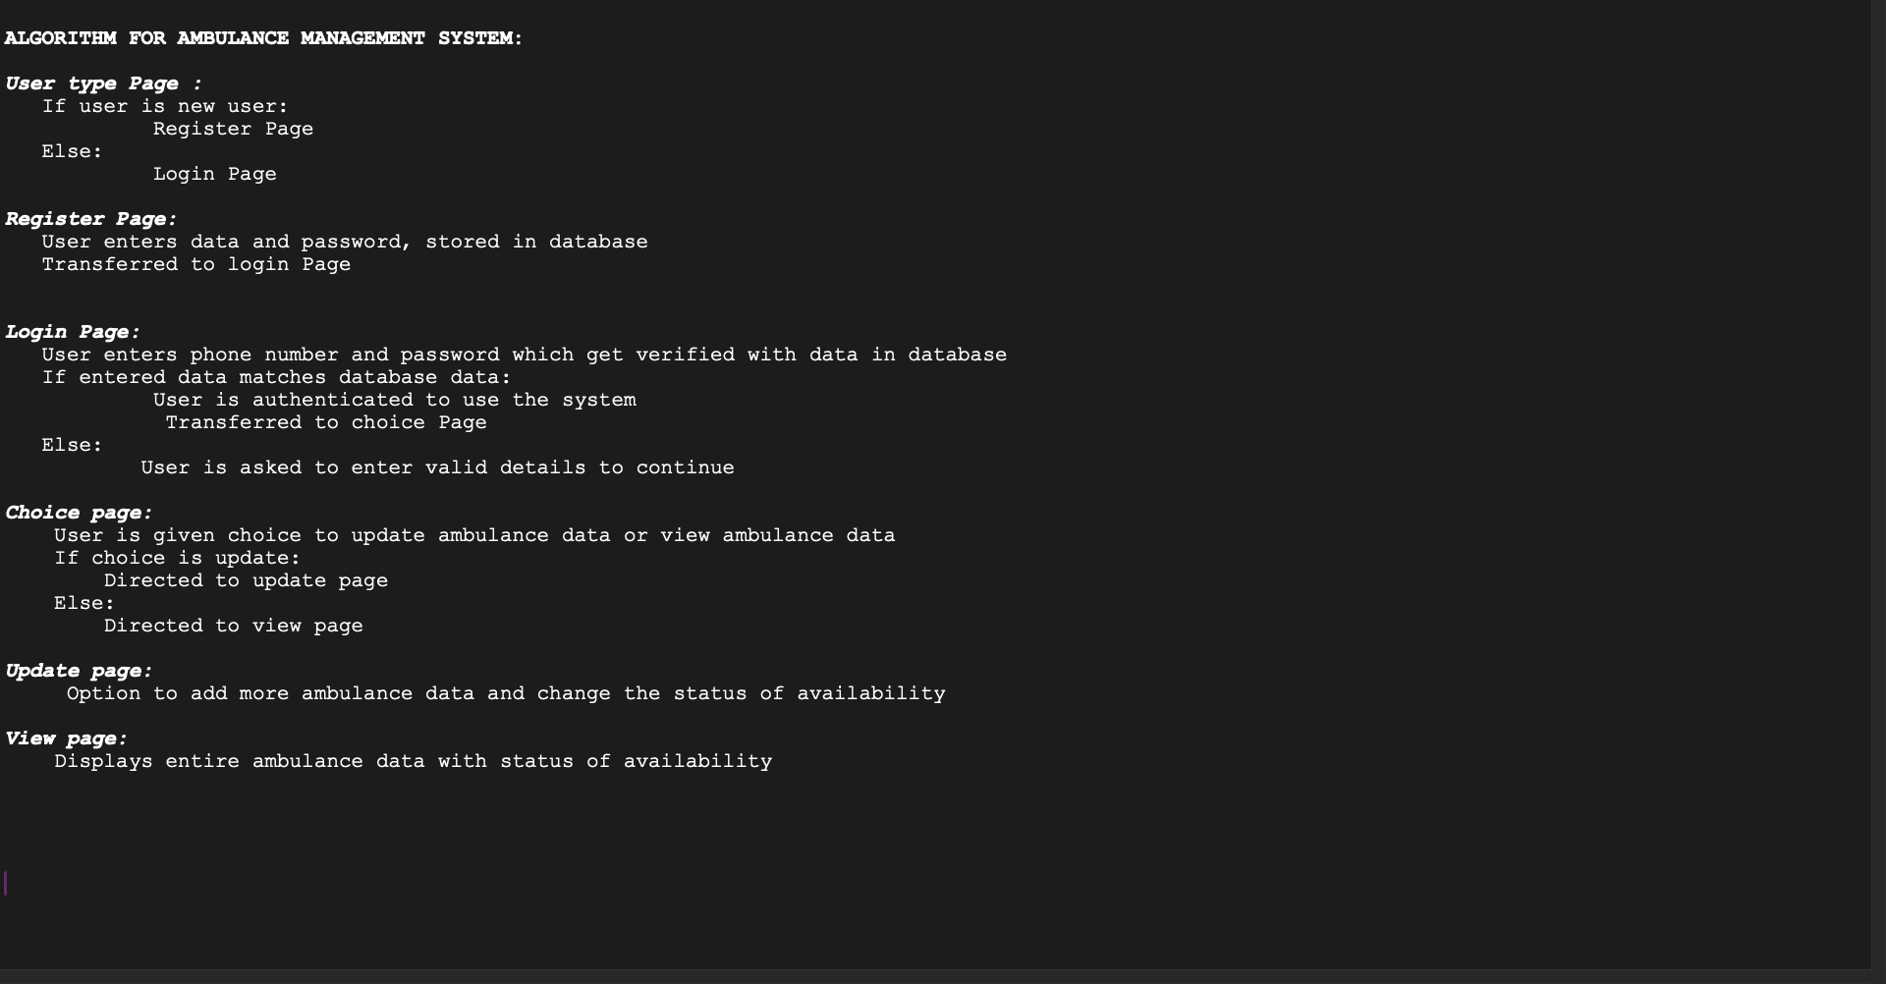
Algorithm
‹#›

Slide 12
Methodology
The development of an Ambulance Management System using Java involves various components to ensure a robust and efficient system. Below are some of the basic components that might be used in such a system:
1.User Interface (UI): Graphical User Interface (GUI): Java provides GUI components through libraries like Swing for creating user-friendly interfaces. The UI allows users to interact with the system, including functionalities for dispatching ambulances, viewing maps, and inputting patient information.
2.Database Connectivity: We are using MYSQl with connection java and using it to create databases and tables to store patient information, driver and ambulance details and hospital information.
3.Backend Logic: Java Classes and Methods: The core functionality of the system is implemented through Java classes and methods. These classes may include Ambulance, Patient, Driver, and others, each encapsulating specific functionalities and data.
‹#›

Slide 13
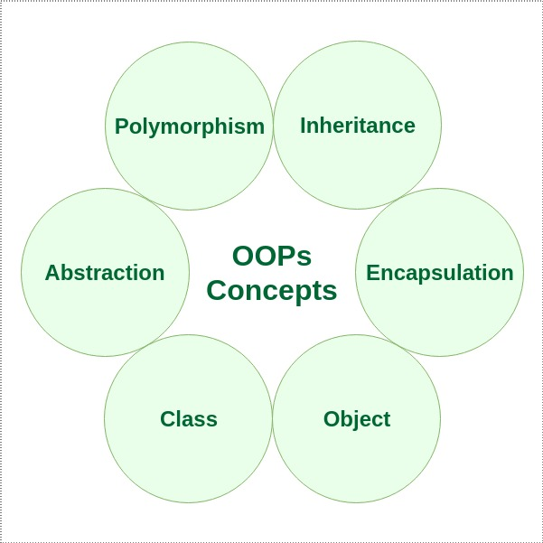
Methodology
4.Exception Handling: Java Exception Handling: Java provides robust mechanisms for handling exceptions, ensuring that the system can gracefully manage errors and exceptions that may arise during runtime.
5. OOPS CONCEPTS:

Slide 14

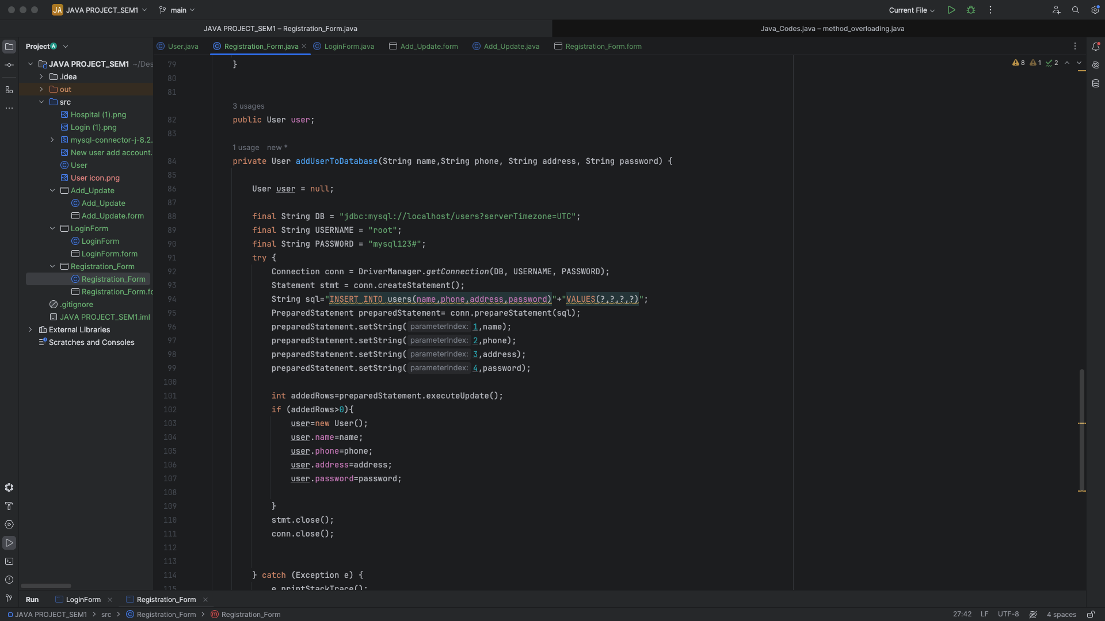
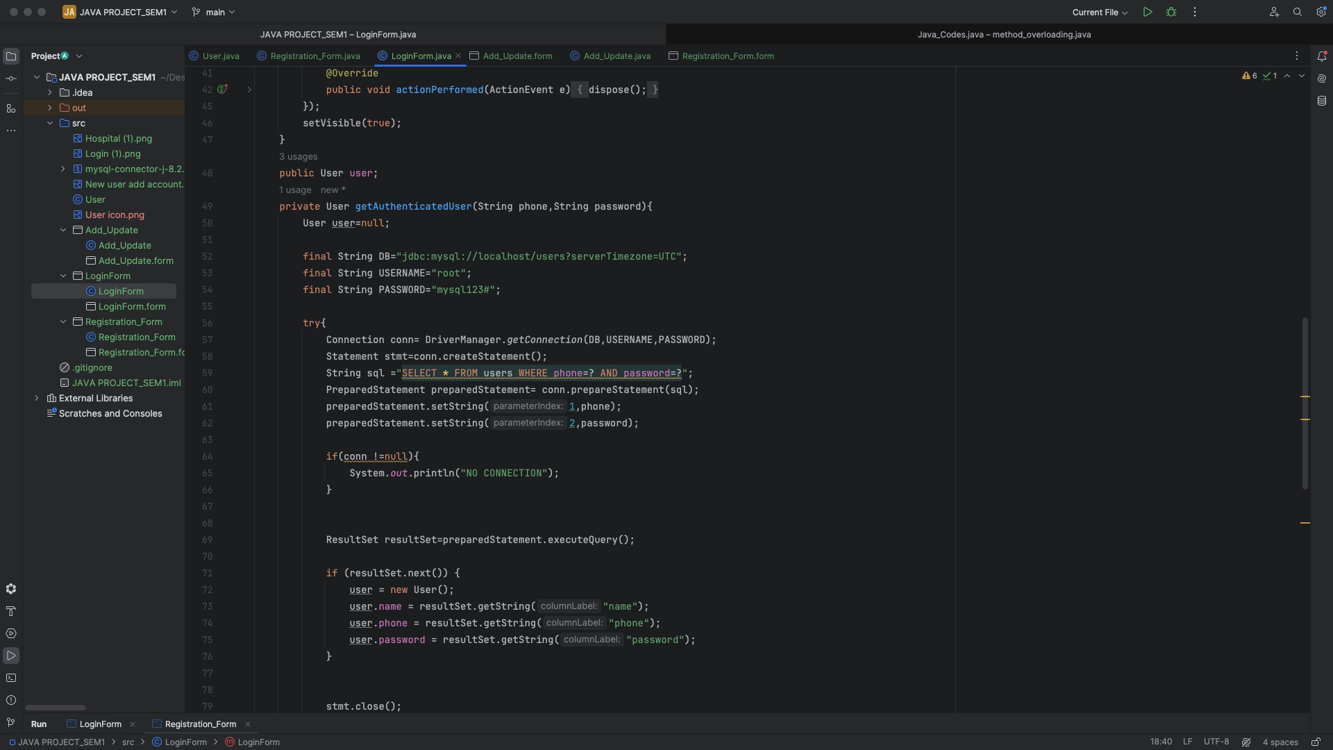
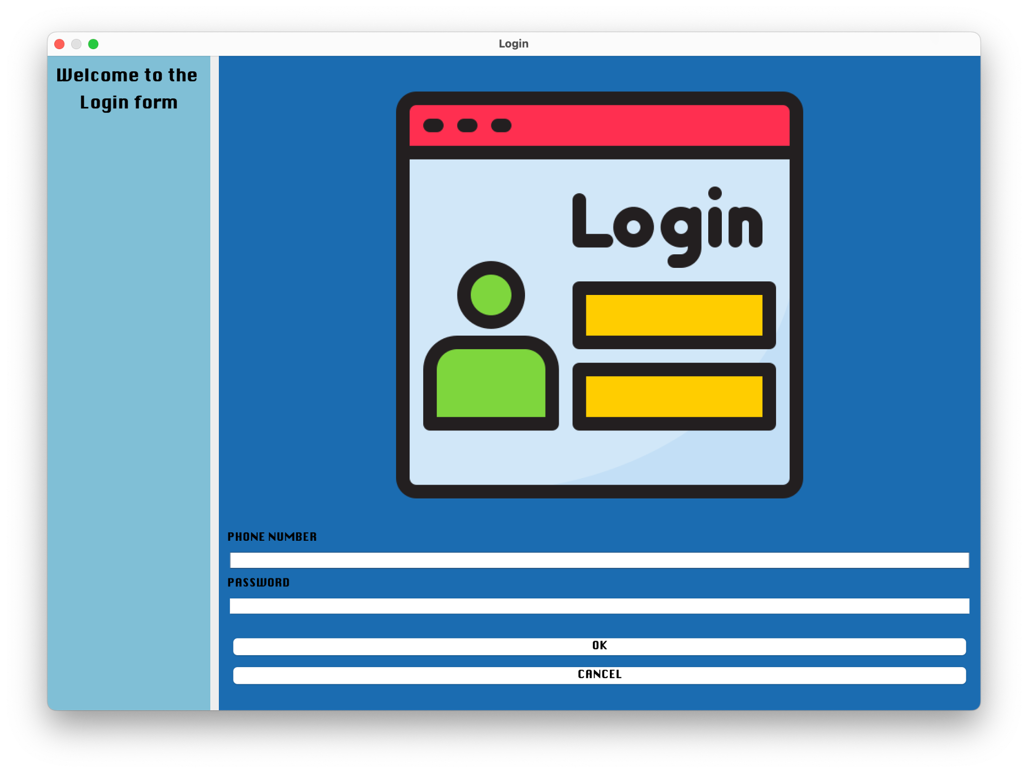
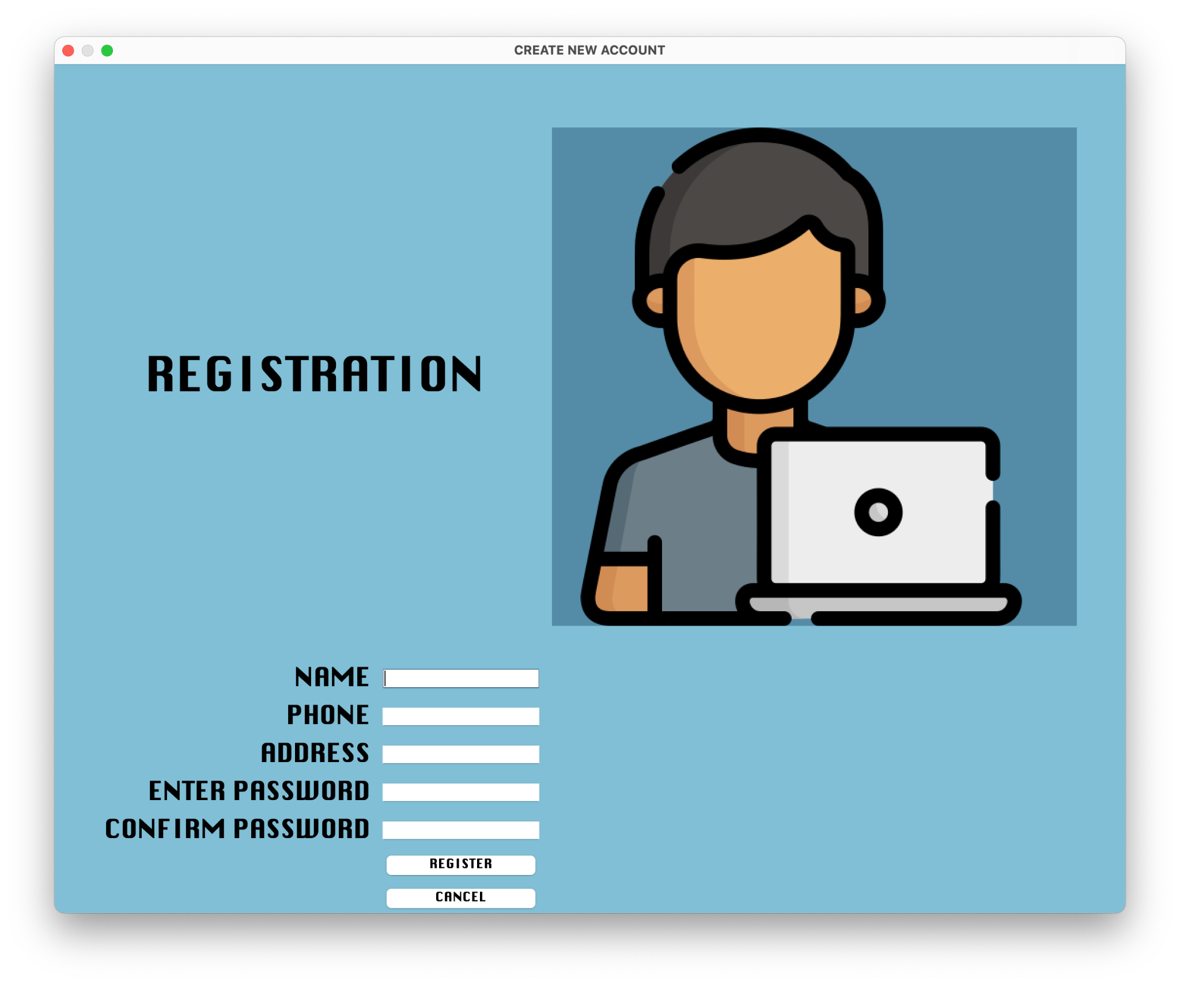
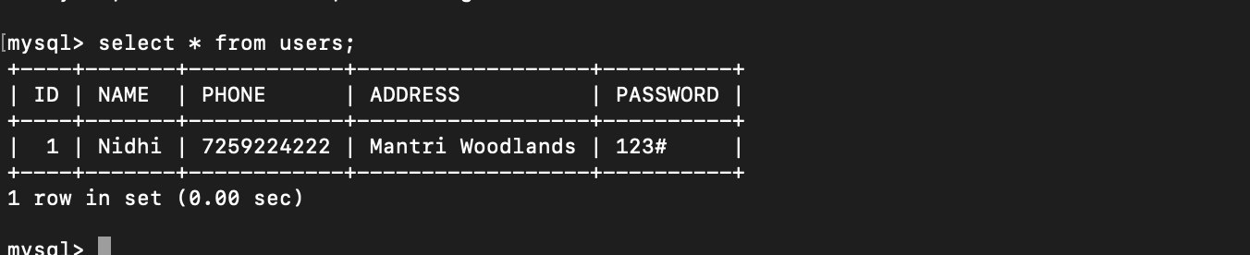
CODE SNIPPETS

Slide 18
SQL BACKEND:

Slide 19
Plan Work for Phase-2
We are going to implement the plan that we created in phase-1 to creating a working model in phase-2.
Actual coding part using Swing for GUI and Mysql for database Management.
Demonstration of the working of the Ambulance Management System.
‹#›

Slide 20
Results and discussion
The application should excel in addressing the general requirements of a prolonged sign-in process, all while ensuring the secure and authentic verification of the user, particularly in the case of drivers.
In this system, the primary function of the hospital is to serve as a database, offering essential and prompt information regarding patients or ambulances
‹#›

Slide 21
Conclusion
In conclusion, the development of the Ambulance Management System using Java will prove to be a significant stride towards enhancing emergency medical services and improving overall patient care. This system efficiently addresses the critical challenges faced in ambulance management, offering a streamlined and automated approach to dispatch.
By leveraging the power of Java, we can create a robust and scalable solution that is not only user-friendly but also adaptable to the dynamic needs of emergency response teams.
‹#›

